Slide 1

SMART INDIA HACKATHON 2026
Problem Statement ID – SIH26117
Problem Statement Title- Sovereign On-Premise Agentic AI Workbench
Theme- Smart Automation
PS Category- Software
Team ID-
Team Name – HYPERION

Slide 2

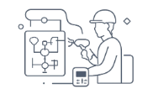



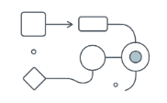


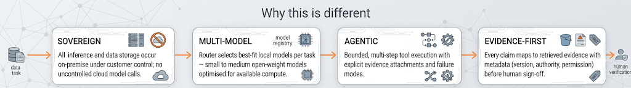
Idea — Solution Pipeline
01 • CAPTURE
02 • UNDERSTAND
03 • ROUTE
04 • GROUND
Ingest multimodal industrial inputs: documents (PDFs, scanned reports), images (photos, diagrams), audio (inspection recordings) and code artifacts. Capture focuses on fidelity, page layout and provenance metadata.
Multimodal Pipeline uses GLM-OCR + Whisper.cpp + local image/document processing → extract text, table structures, form fields, layouts, handwritten fragments and audio transcripts into a structured local context.
Intelligent Model Router uses Projective + Model Registry + Resource-Aware Scheduling → match task, modality and available compute to the optimal on‑premise model for inference.
Local Knowledge Layer (RAG + Vector DB) with version / authority / permission metadata → retrieve authorized evidence and authoritative context for grounding model outputs.
05 • ANALYZE
06 • VERIFY
07 • DELIVER
Agent Orchestrator uses DeepSeek Harness, MCP and Python tools → perform bounded, tool-based multi-step analysis (calculations, simulations, code generation) within defined safety envelopes.
Human Verification via risk-based verification and evidence mapping → escalate high-risk claims for human review; map outputs back to source evidence for auditability.
Controlled output generation: DOCX, XLSX, working code and a complete audit trace — all produced and stored on‑premise with provenance and versioning.
Why this is different
SOVEREIGN
MULTI‑MODEL
AGENTIC
EVIDENCE‑FIRST
All inference and data storage occur on‑premise under customer control; no uncontrolled cloud model calls.
Router selects best-fit local models per task — small to medium open-weight models optimised for available compute.
Bounded, multi-step tool execution with explicit evidence attachments and failure modes.
Every claim maps to retrieved evidence with metadata (version, authority, permission) before human sign-off.

Slide 3
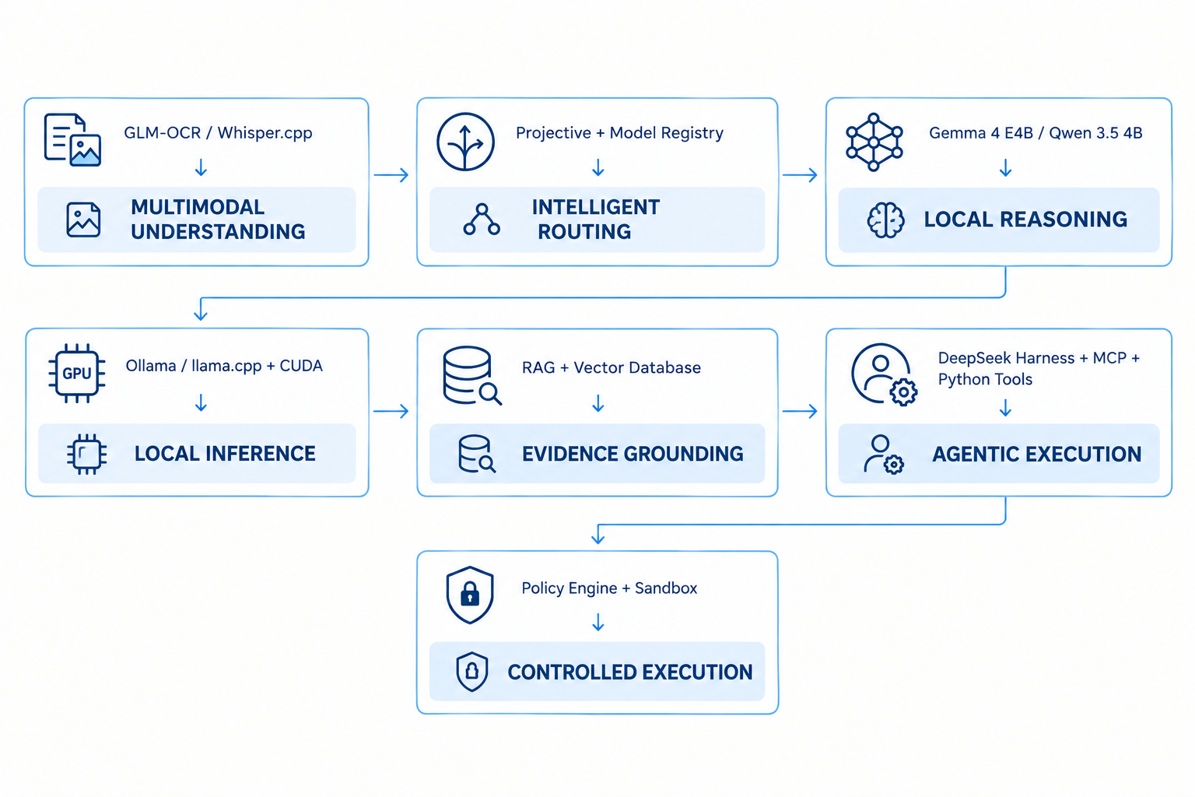
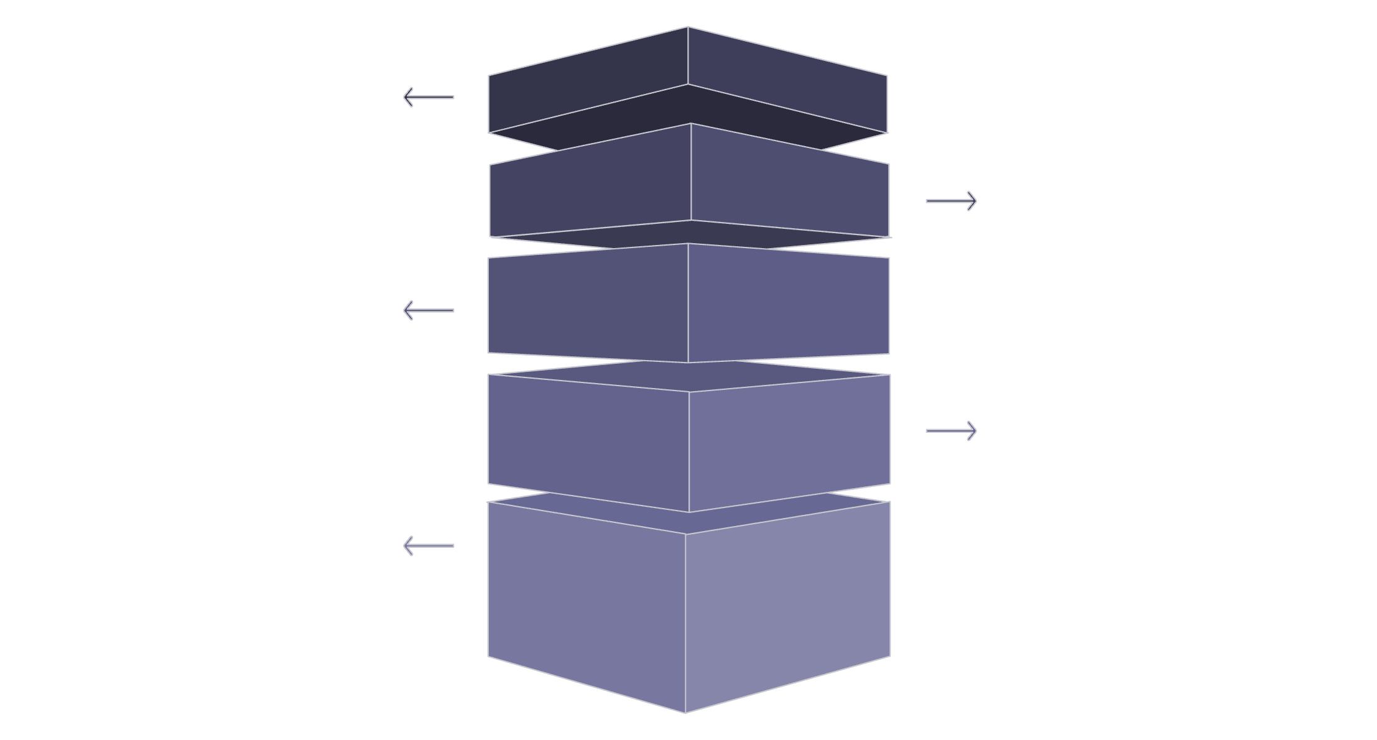

Technical Approach-Layered Architecture
HYPERION architecture is organized as a vertically layered system where each layer has a clear technical role: input ingestion, multimodal understanding, agent orchestration, model routing, local inference and grounding.
Engineer Input
Top-level engineer/manager directives and prompts.
Multimodal Pipeline
GLM-OCR and Whisper.cpp process text and audio.
Agent Orchestration
DeepSeek Harness, MCP and Python tools coordinate actions.
Model Router
Projective routing, registry and resource-aware scheduling.
Local Inference & Grounding
Gemma/Qwen runtimes (Ollama/llama.cpp/CUDA) with local RAG vector DB.
Layer descriptions (concise): - Layer 1 — Industrial Input: Engineer/Manager submits PDFs, images, scans, audio, spreadsheets or code. - Layer 2 — Multimodal Pipeline (Understand): GLM‑OCR, Whisper.cpp, local parsing convert raw inputs into structured local context (text, tables, layout, timestamps, provenance). - Layer 3 — Agent Orchestration (Orchestrate): DeepSeek Harness + MCP + Python Tools coordinate bounded tool calls and deterministic workflows. - Layer 4 — Intelligent Model Routing (Route): Projective + Model Registry + Task Classification + Resource‑Aware Scheduling choose the correct model for the job. - Layer 5 — Local Inference (Infer): Gemma 4 E4B, Qwen 3.5 4B running via Ollama, llama.cpp and CUDA on on‑premise compute (8 GB VRAM). - Layer 6 — Knowledge / Grounding (Ground): Local RAG + vector store supply versioned, permissioned evidence for verification and audit.

Slide 4
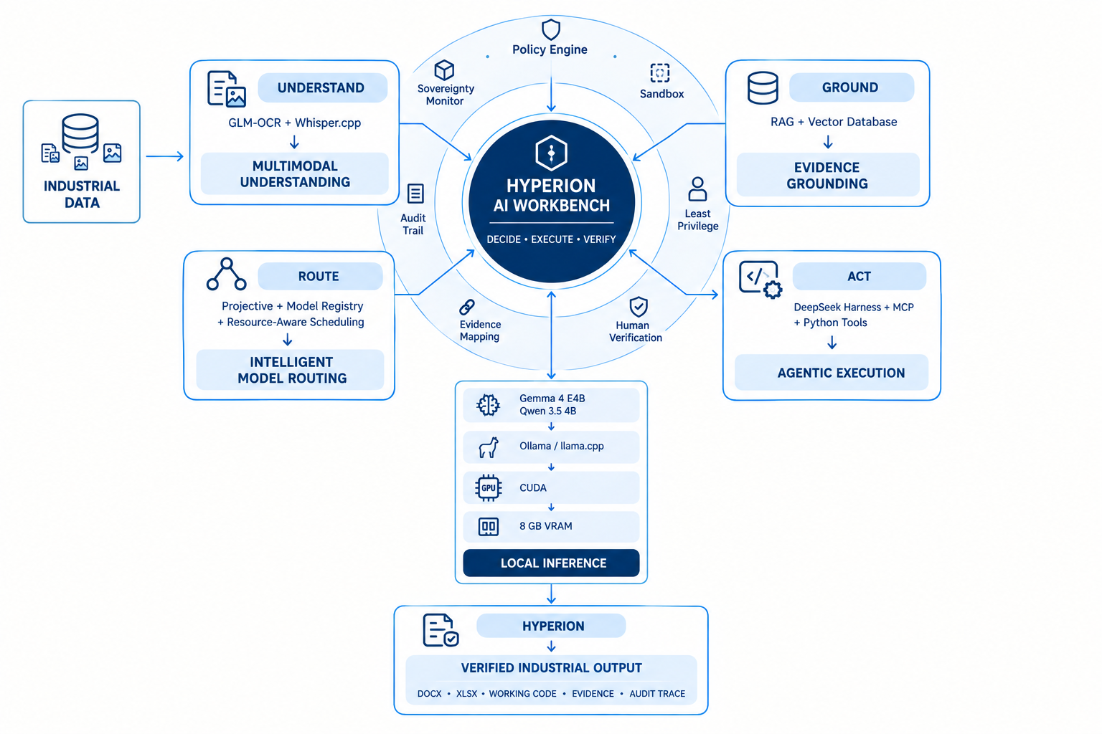
HYPERION Component Details
Multimodal Pipeline
Uses: GLM-OCR + Whisper.cpp + local document and image processing. Function: Extracts text, tables, layouts, handwriting and audio transcripts. Output/Capability: Structured local context (document object model, parsed tables, timestamped transcripts) that preserves provenance.
1
2
Model Router
Uses: Projective + Model Registry + Resource-Aware Scheduling. Function: Select model by task type, modality, available compute and model capability. Output/Capability: Task-specific inference selection guaranteeing execution within on‑premise compute constraints.
3
4
Local Inference Layer
Uses: Ollama + llama.cpp + CUDA + local open‑weight models (Gemma 4 E4B, Qwen 3.5 4B). Function: Execute secure inference on devices with constrained VRAM (8 GB), using quantised models and runtime optimisations. Output/Capability: Confidential, auditable inference results without a cloud-model path.
Agent Orchestrator
Uses: DeepSeek Harness + MCP + Python Tools + Tool Gateway. Function: Run bounded multi‑step analysis workflows, call deterministic tools (calculators, simulators), capture intermediate evidence. Output/Capability: Reproducible analysis chains with attached evidence and structured outputs (calcs, code snippets, reports).

Slide 5
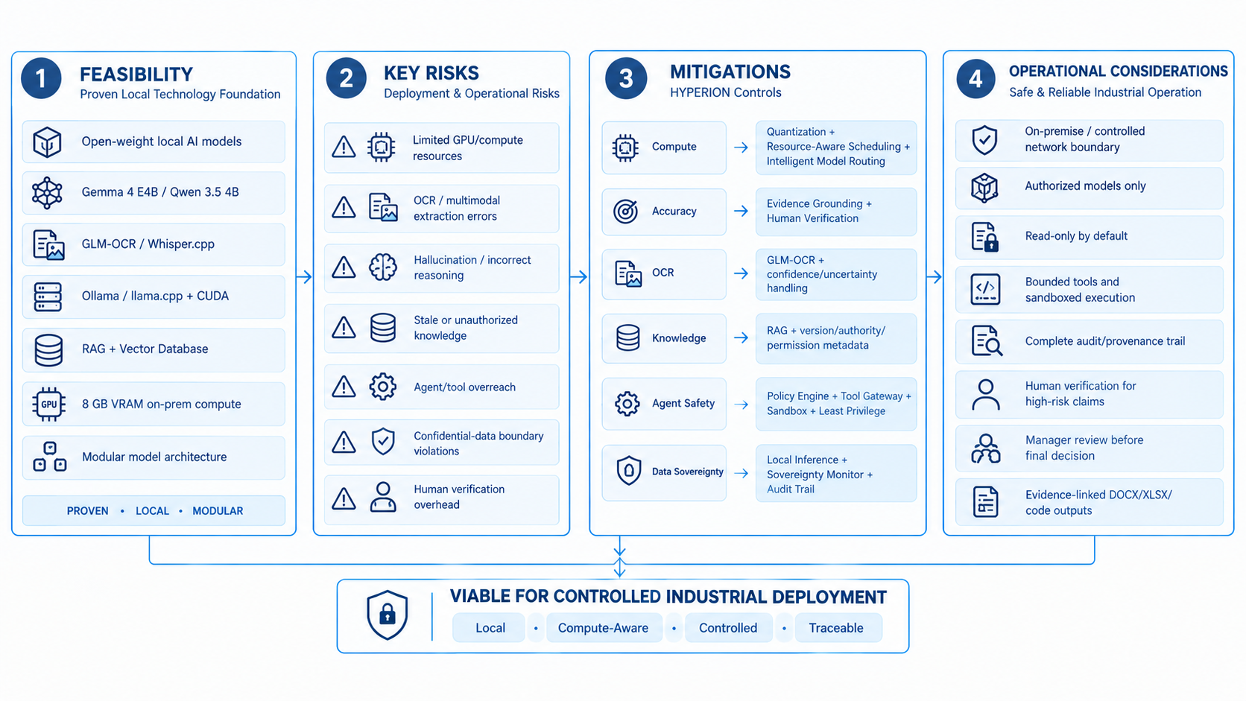
Feasibility,Risks & Migitations
Feasibility
The architecture leverages existing open-weight models and on‑prem inference runtimes optimised for 8 GB VRAM. Components (GLM-OCR, Whisper.cpp, Ollama, llama.cpp, vector DBs) are mature and integrable within an enterprise stack.
Key Risks
Model accuracy for domain-specific engineering language
Compute limits causing latency on large multimodal tasks
Evidence provenance gaps from noisy inputs (handwriting, low-quality scans)
Mitigations
Fine-tune or adapter‑tune local models on industrial corpora; use task-specific small models for deterministic subtasks.
Router performs resource-aware splitting: offload heavy offline processing to scheduled on‑prem batch nodes; prioritise low-latency tasks to lower-parameter models.
Signal quality scores from GLM-OCR/Whisper.cpp feed verification pipeline; flag low-confidence extractions for human review.
Operational Considerations
Deployment patterns: air‑gapped site installation, containerised runtimes, hardware profiles (8 GB VRAM edge nodes, optional clustered inference nodes). SecOps: role-based access, encrypted local storage, signed model bundles in the Model Registry.

Slide 6
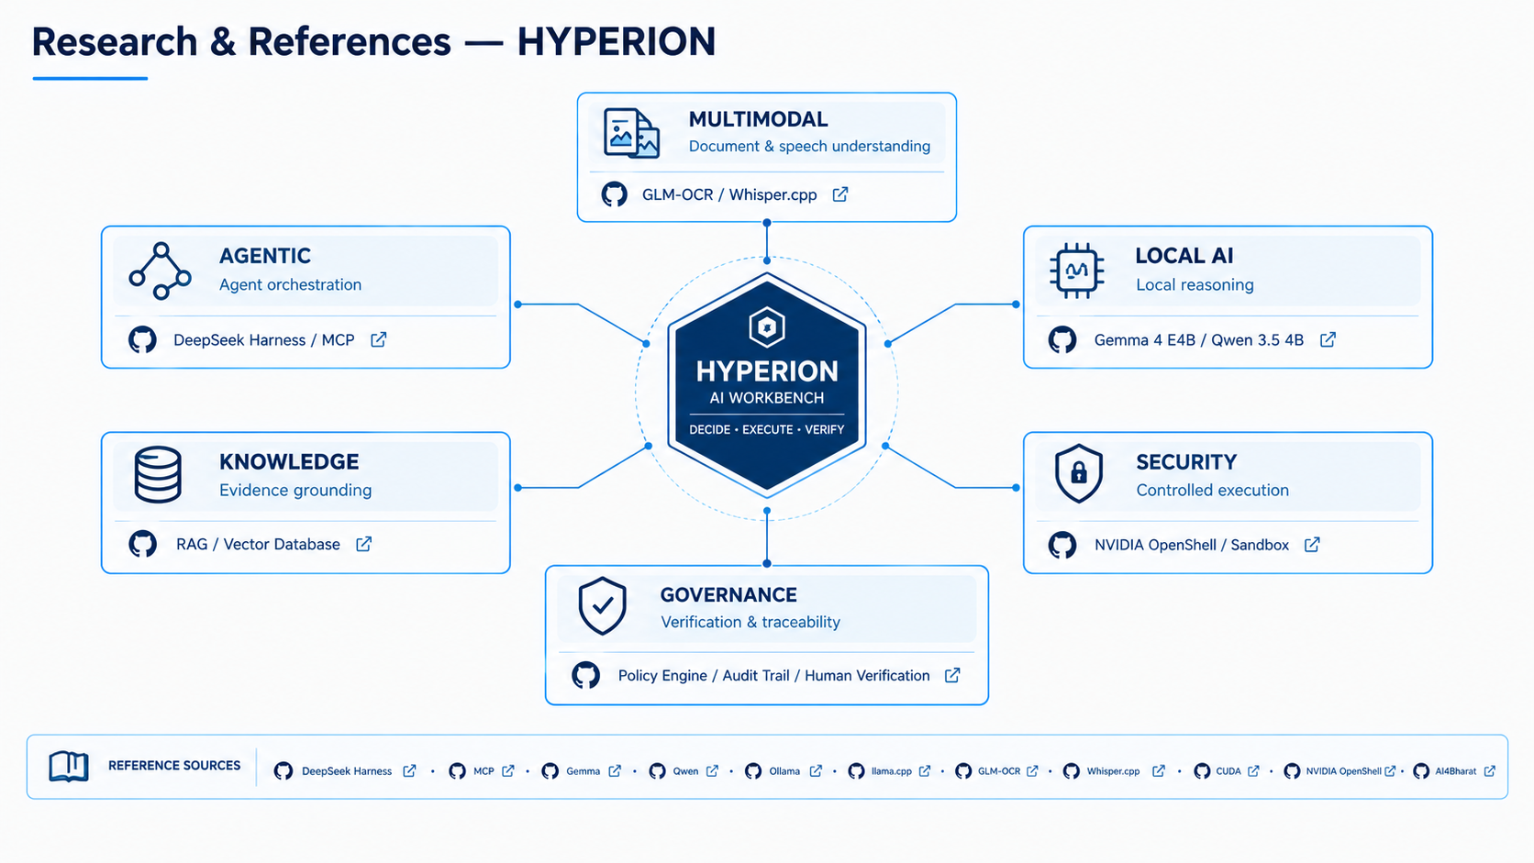
RESEARCH AND REFERENCES
1. Agentic AI / Orchestration
DeepSeek Harness: https://github.com/deepseek-ai/deepseek-harness
DeepSeek Harness Documentation: https://deepseek-harness.github.io/deepseek-harness/
Model Context Protocol (MCP): https://modelcontextprotocol.io/
2. Local Models / Inference
Gemma: https://ai.google.dev/gemma/docs/core
Qwen3.5 4B: https://huggingface.co/Qwen/Qwen3.5-4B
Ollama: https://ollama.com/
llama.cpp: https://github.com/ggml-org/llama.cpp
NVIDIA CUDA: https://developer.nvidia.com/cuda/
3. Multimodal / Document Understanding
GLM-OCR: https://github.com/zai-org/GLM-OCR
Whisper.cpp: https://github.com/ggml-org/whisper.cpp
AI4Bharat: https://ai4bharat.iitm.ac.in/
IndicConformer: https://github.com/AI4Bharat/IndicConformer
4. Security / Sandboxed Execution
NVIDIA OpenShell: https://github.com/NVIDIA/OpenShell
OpenShell Documentation: https://docs.nvidia.com/openshell/
OpenShell Quickstart: https://docs.nvidia.com/openshell/get-started/quickstart
5. Knowledge / Evidence Grounding
RAG: https://www.pinecone.io/learn/retrieval-augmented-generation/
FAISS: https://github.com/facebookresearch/faiss
Chroma: https://github.com/chroma-core/chroma
6. Architecture / Routing Research
Projective: https://github.com/projectivehq/projective
Prime Agent: https://github.com/PrimeIntellect-ai/prime
Model Registry / MLflow: https://mlflow.org/docs/latest/ml/model-registry/
MCP: https://github.com/modelcontextprotocol/modelcontextprotocol

